Slide 1

Department of Computer Science and Engineering
FINAL REVIEW
BATCH NO:14
FUEL MANAGEMENT APP
GUIDED BY,
PROF: NISSU SIMON
DEPARTMENT OF COMPUTER
SCIENCE AND ENGINEERING
PRESENTATION BY,
GOKUL A NAIR
GOKUL N HARI
JOEL K ABRAHAM
ROSHAN ROY

Slide 2
ABSTRACT
Fuel Management App is convenient and users can order fuel directly to their location through the app, eliminating the need to visit gas stations.
It has a user-friendly interface and intuitive interface that allows users to place orders quickly and easily
The location services provided by the GPS will accurately pinpoint the user's location for seamless delivery
The secure payment offers secure payment options within the app, ensuring transactions are safe and reliable.
The Users can specify the type and quantity of fuel required, as well as schedule deliveries at their convenience.

Slide 3
INTRODUCTION
In our busy lives, finding time to refuel our vehicles can be a hassle. But what if you could get fuel delivered straight to your car, wherever you are? That's where fuel delivery apps come in. These handy apps let you order fuel with just a few taps on your phone, saving you from trips to the gas station. In this introduction, we'll explore how fuel delivery apps make refueling easier and more convenient, revolutionizing the way we keep our vehicles running smoothly.
On-Demand Fuel Delivery
Fuel Variety
Transparent Pricing
Safety First
Delivery Tracking

Slide 4
PROBLEM STATEMENT
Inefficiencies in traditional refueling methods, such as long queues at gas stations.
Limited options for individuals and businesses to have fuel delivered to their location.
Environmental concerns related to emissions from idling vehicles waiting at gas stations.
Ensuring the safety and security of fuel delivery.
Overcoming regulatory and safety standards related to fuel transportation and establishing a reliable and user-friendly mobile application.

Slide 5
LITERATURE REVIEW
SL.NO | PAPER NAME | TECHNOLOGY | ADVANTAGE | DISADVANTAGE
1. | IoT Based Automation In Doorstep Fuel Delivery System (2022) | Sensors and actuators | Enhanced efficiency, Real-Time monitoring, Remote management | Cybersecurity risks, Data privacy concerns, Reliablity issues
2. | Fuelling the economy :A critical review of liquid fuel regulation.(2022) | Geographic Information System(GIS) , Regulatory softwares. | Consumer Protection, Market Fairness, Quality Assurance. | Unintended Consequences, Variability in Regions
3. | Android Application for On-Road fuel demand(2022) | Geolocation services, Payment gateway. | Business Solutions, Reduced Emissions. | Delivery Delays ,Limited Geographic Coverage, Initial Investment

Slide 6
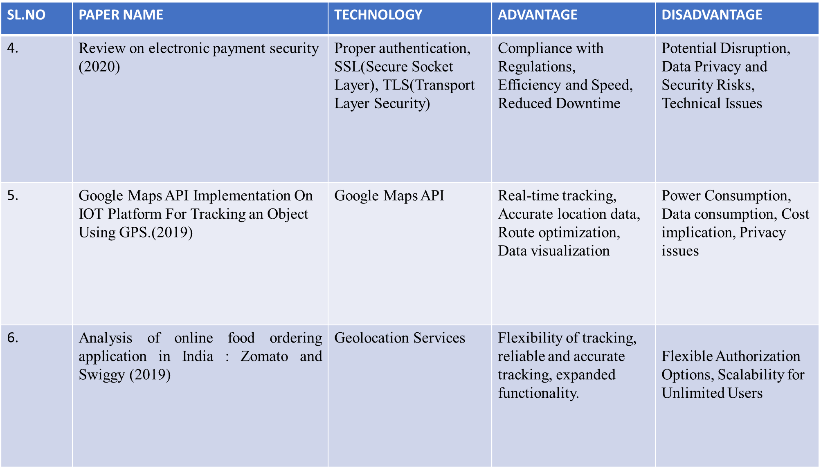

Slide 7
SL.NO | PAPER NAME | TECHNOLOGY | ADVANTAGE | DISADVANTAGE
7. | Technical review on fuel delivery application (2018) | GPS,Mobile application, Automated Billing system | Convenience, Time Saving, Precise, Delivery Payment Options | Safety Concerns, Regulatory Compliance, Competition Dependence on Technology, User Education
8. | Research on the optimization of vehicle distribution route in logistics enterprise. (2018) | GPS and GIS | Reduced Wear and Tear, Real Time Adjustments, Improved Customer Service | Complexity ,Resistance to Change, Sensitivity to Input Data
9. | Design and implementation of a GPS based personal traffic system (2016) | GPS/GSM, smartphone application to track and display user locations in real-time. | Improved efficiency, Location awareness | Power consumption ,Reliance on technology.
10. | GSM Technology: Architecture, Security and Future Challenges (2014) | GSM Technology,T | Consumer Protection, Market Fairness, Quality Assurance. | Unintended Consequences, Variability in Regions
SL.NO | PAPER NAME | TECHNOLOGY | ADVANTAGE | DISADVANTAGE
7. | Technical review on fuel delivery application (2018) | GPS,Mobile application, Automated Billing system | Convenience, Time Saving, Precise, Delivery Payment Options | Safety Concerns, Regulatory Compliance, Competition Dependence on Technology, User Education
8. | Research on the optimization of vehicle distribution route in logistics enterprise. (2018) | GPS and GIS | Reduced Wear and Tear, Real Time Adjustments, Improved Customer Service | Complexity ,Resistance to Change, Sensitivity to Input Data
9. | Design and implementation of a GPS based personal traffic system (2016) | GPS/GSM, Smartphone application to track and display user locations in real-time. | Improved efficiency, Location awareness | Power consumption ,Reliance on technology.
10. | GSM Technology: Architecture, Security and Future Challenges (2014) | Global System for Mobile Application(GSM) | Wide coverage , Digital clarity, Secure. | Limited data speed , Capacity Limitation

Slide 8
PROPOSED SYSTEM
Navigation Integration - Help drivers efficiently navigate to customer’s locations for fuel deliveries.
Seamless UI - It ensures a user-friendly experience, with intuitive navigation, clear information display, and easy-to-use features.
User Interface - Fuel delivery app is designed to be user-friendly, allowing customers to easily place orders, track deliveries, and make payments.
Payment Integration - It allows users to securely pay for their orders directly within the app using various methods like credit cards or mobile wallets, streamlining the transaction process

Slide 9
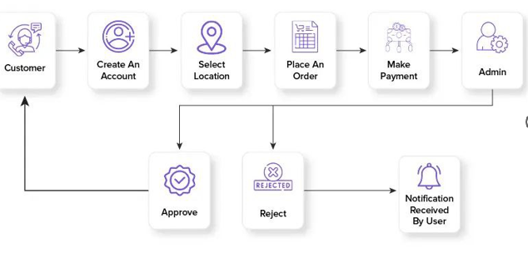

A. SYSTEM ARCHITECTURE

Slide 10
B.MODULES DESCRIPTION
1. User Authentication:
Allow users to sign up, sign in, and manage their accounts securely.
Authentication method is phone number verification.
2. Fuel Ordering:
Enable users to place orders for fuel delivery.
Provide options to select fuel type, quantity and preferred delivery time.
3. Payment Gateway Integration:
Integrate payment gateways to facilitate secure online payments.
4. Real-time Tracking:
Implement real-time tracking functionality to allow users to track the status of their fuel delivery.

Slide 11
RESULT AND DISCUSSION
Increased convenience for users.
Improved accessibility to fuel, especially in remote areas or during emergencies.
Enhanced efficiency in fuel delivery operations.
The app helped cut down on pollution by streamlining delivery routes and minimizing unnecessary trips to gas stations.

Slide 12
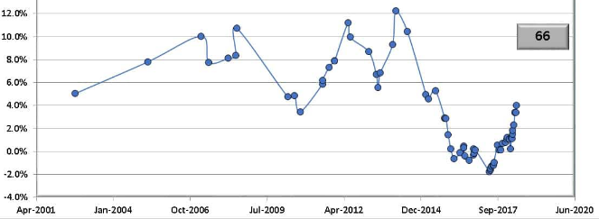


GRAPHICAL REPRESENTATION
FUEL PRICE GRAPH

Slide 13
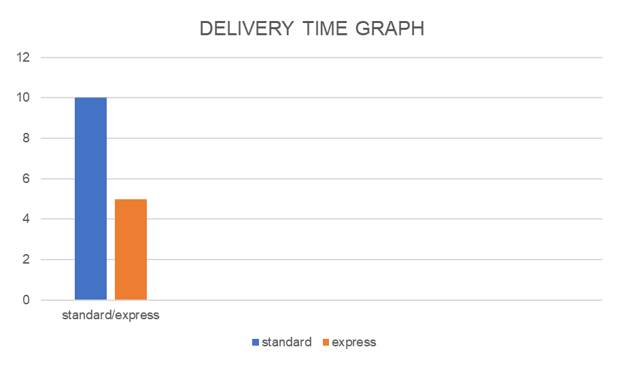

Standard | Time = t
Express | Time = standard/2

Slide 14
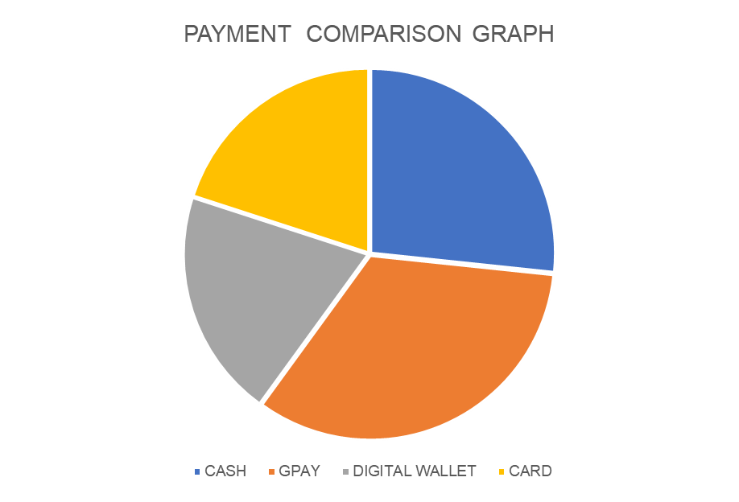

PAYMENT TYPE | EFFICIENCY IN %
Cash | 40
Gpay | 50
Digital Wallet | 30
Card | 30

Slide 15
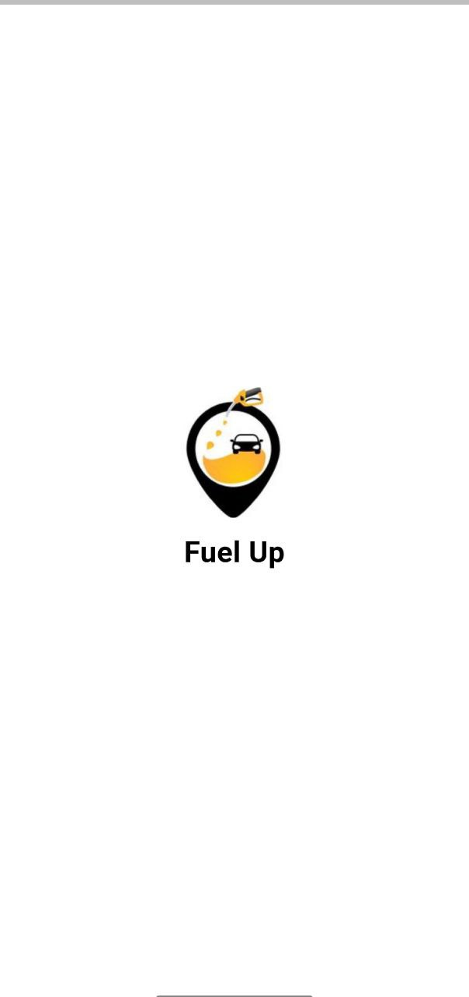
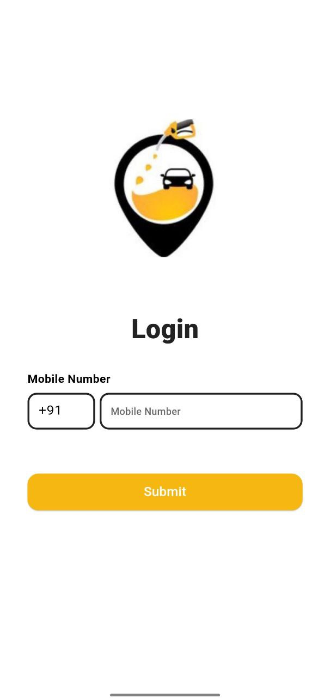
EXPERIMENTAL RESULTS

Slide 16
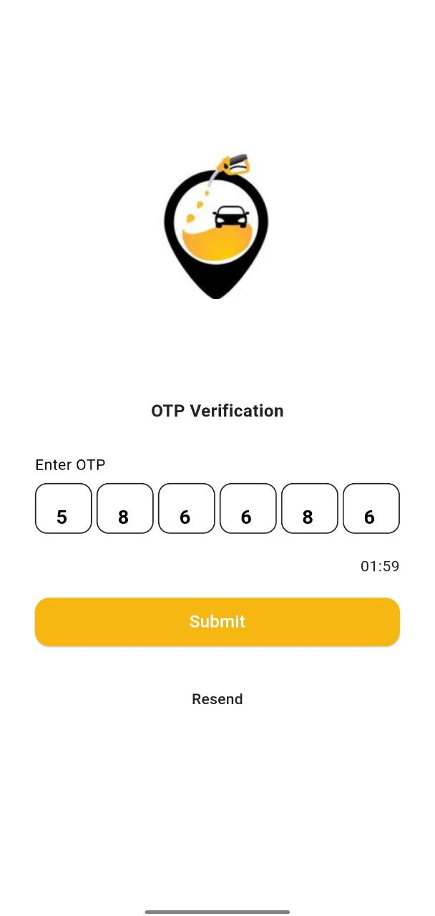
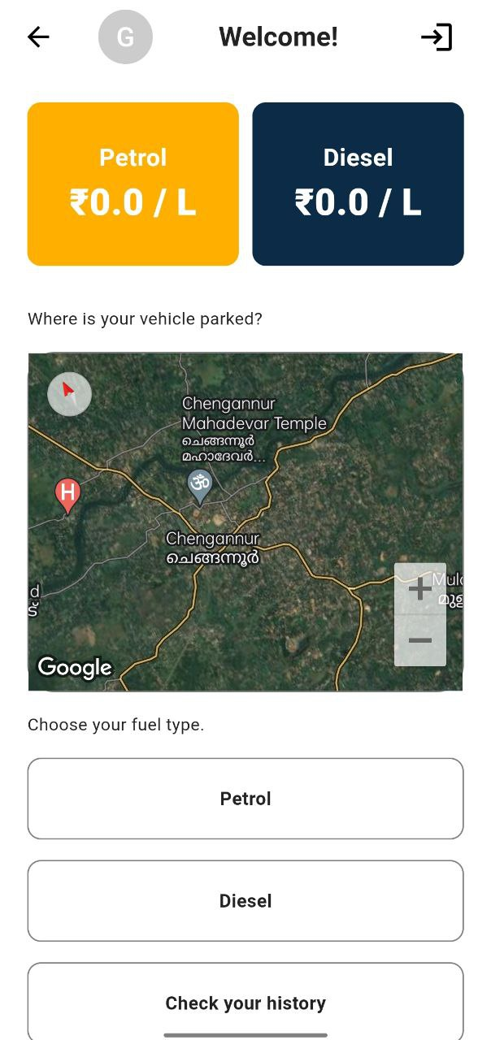

Slide 17
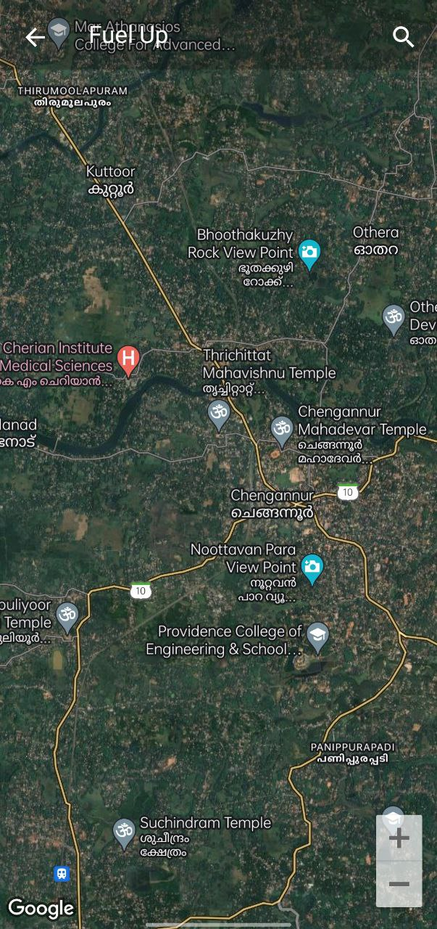
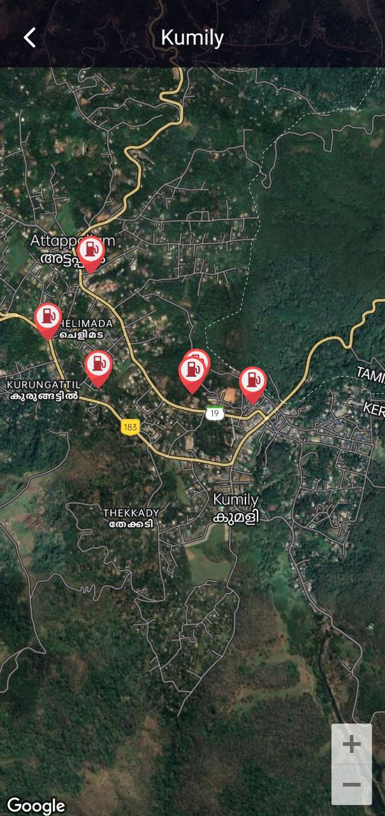

Slide 18
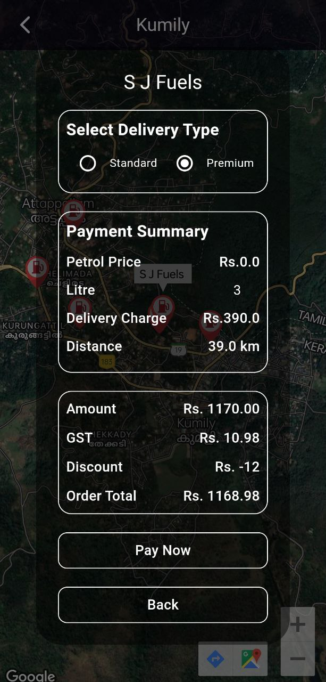
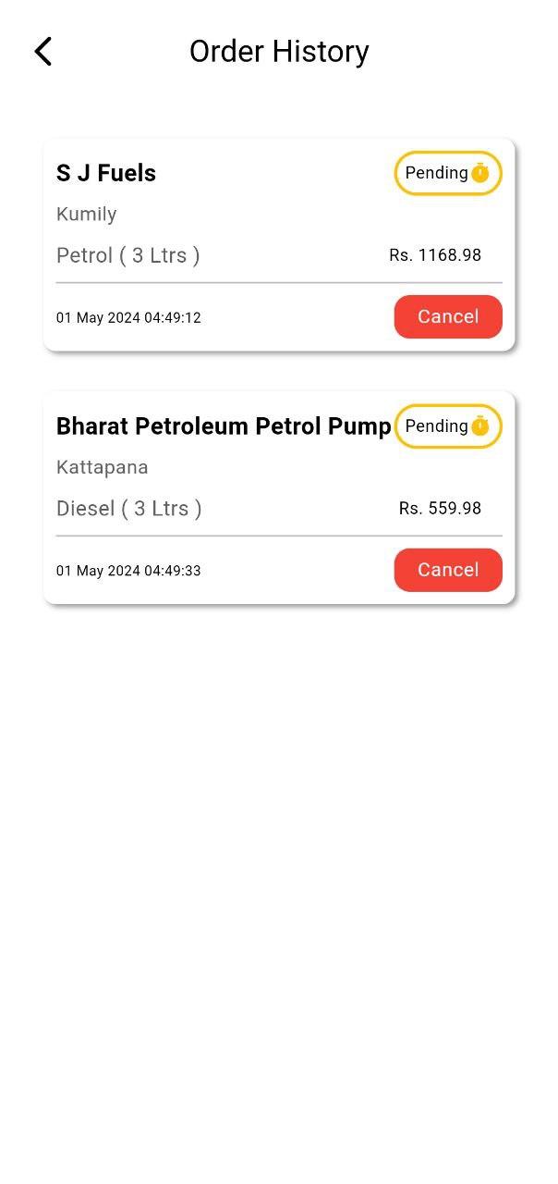

Slide 19
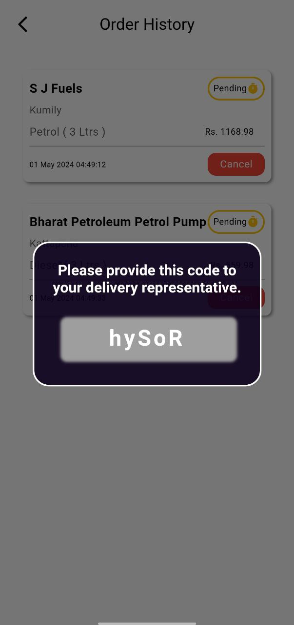
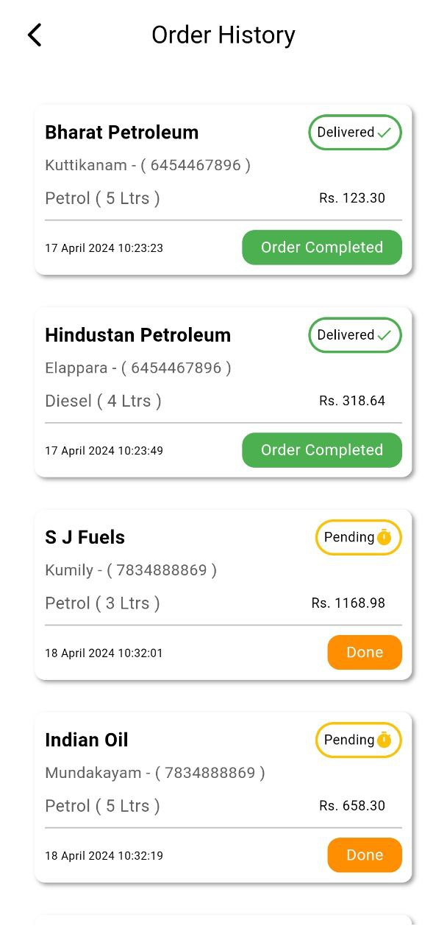
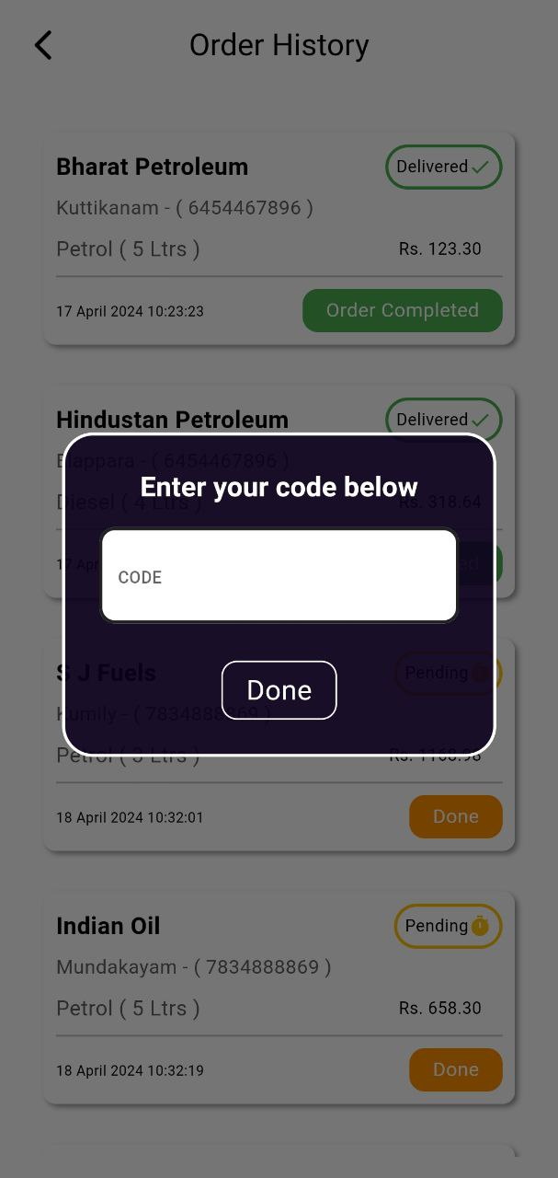

Slide 20
CONCLUSION AND FUTURE ENHANCEMENT
Fuel delivery apps are convenient, efficient, and sustainable solutions for customers and businesses.
Developing a fuel delivery app requires registration and licensing, transport network, alliance with fuel suppliers, and on-demand app development.
Upcoming task include subscription plans for regular fuel delivery to homes or businesses, providing convenience and cost savings for frequent users.
We will continue to refine existing features and introduce new functionalities to enrich the user experience.

Slide 21
REFERENCES
[1] Areeg Abubakr Ibrahim Ahmed, Siddig Ali Elamin Mohammed, Mohamed Almudather Mahmoud Hassan Satte “Fuel management system” In Proceedings of the IEEE Conference on 2017 International Conference on Communication, Control, Computing and Electronics Engineering (ICCCCEE) 2019.
[2] Sunil Chandrasiri “Demand for road-fuel in a small developing economy” in proceedings of research gate on 2016.
[3] Nielsen india private limited “All India Study on Sectoral Demand of Diesel & Petrol” submitted in the Ministry of Petroleum and Natural gas in 2013.
[4] J. P. Stempien and S. H. Chan, ”Comparative study of fuel cell, battery and hybrid buses for renewable energy constrained areas,” Journal of Power Sources, vol. 340, pp. 347-355, 2017/02/01/ 2017.
[5] R. O’hayre, S.-W. Cha, F. B. Prinz, and W. Colella, Fuel cell fundamentals: John Wiley Sons, 2016.
[6] Corbett, C., Das Nair, R. & Roberts, S. (2011). Bargaining power and market definition: a reflection on two mergers. Journal of Economic and Financial Sciences, 4(2), pp. 147-166.
[7] Creamer, T.(2013). Big Manufacturers Turn to Courts amid Unhappiness with-Gas Pricing Sasol Contract Talks. [Online] Available: www.engineeringnews.co.za. (Accessed 10 November 2013).

Slide 22
[8] Das Nair, R. & Mncube, L. (2012).The role of information exchange in facilitating collusion-insights from selected cases. In Moodaliyar, K. & Roberts, S.(eds.) The development of competition law and economics in South Africa, HSRC Press.
[9] Yuqing Zhang. Study on Optimization Model of Cold Chain Logistics Distribution System [J]. Journal of Xi'an Aeronautical University, 2017,35(5): 72-76.
[10] Zhang Ting, Lai Pingzhong. Optimization of Dynamic Vehicle Routing of Urban Distribution Based the Real-time Information [J]. Systems Engineering, 2015,33(7): 58-64.

Slide 23
THANK YOU

